Slide 1
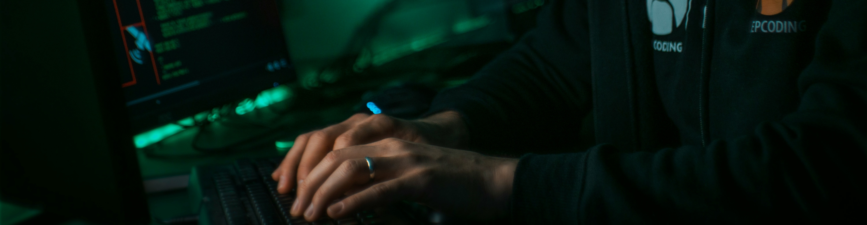
Security Event Management
Information Systems Auditing
Class VII

Slide 2
Class Recap

Slide 3
Class Roadmap
IT Governance: Concept
IT Governance: Audit Program
IS Acquisition and Development
IS Implementation
IS Operation & Business Resilience
Protection of Information Assets I: Part A
Protection of Information Assets II: Part B
Mid-Term Exam
Basic of Data Analysis
Risk and Control
Parallel Simulation
Analytics and Sampling
Substantive Testing: Sales Cycle
Substantive Testing: Expenditure Cycle
Audit Report
Final Exam

Slide 4
Covered So Far
IT Governance and its audit concept through COBIT 2019 standard
How Systems are Acquired & Developed
How Systems are Implemented
How to make sure the system is running well and prevented to have prolonged downtime
Basic rule of thumb to protect information and assets
Remember, the first half of this class will cover domains in CISA Review, as follows:
IS Auditing Process
IT Governance
IS Acquisition, Development, and Implementation
IS Operations and Business Resilience
Protection of Information and Assets

Slide 5
Security Awareness Programs
Information System Attack Methods
Security Testing Tools
Security Monitoring
Incident Response

Slide 6
Intro
#detection #response #human

Slide 7
What This Chapter is About?
While Part A covers the prevention and architecture (like cryptography and access control), Part B shifts focus to detection, response, and the human element.

Slide 8
What This Chapter is About?
Evaluate the effectiveness of Security Awareness Programs (the “Human Firewall”)
Identify common Information System Attack methods (how the bad guys get in)
Distinguish between various Security Testing Tools (penetration testing vs. vulnerability scanning
Understand Security Monitoring techniques (IDS, IPS, SIEM)
Audit the Incident Response process and Forensics procedures

Slide 9
Security Awareness
People are often the weakest link

Slide 10
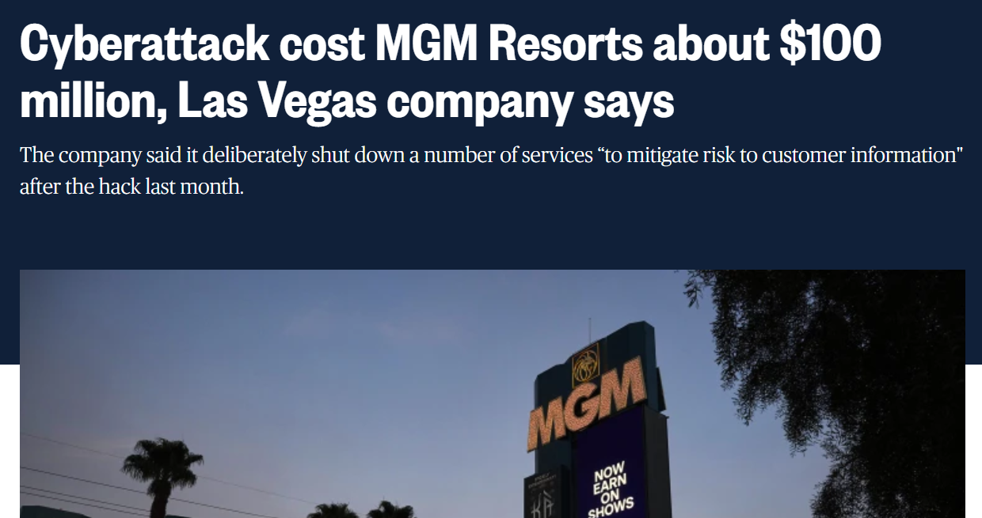
Why Technology Isn’t Enough
The Attack:
Attackers found an employee's information on LinkedIn
They called the IT Help Desk, pretending to be that employee who "lost their phone.”
The Human Failure: The Help Desk agent reset the credentials and gave them to the attacker over the phone.
The Consequence:
Attackers gained "Super Admin" access.
10 days of chaos: Slot machines went dark, hotel room keys stopped working, guests were locked out
Financial Loss: Approx. $100 Million in lost revenue
https://netwrix.com/en/resources/blog/mgm-cyber-attack/

Slide 11
Social Engineering
The psychological manipulation of people into performing actions or divulging confidential information.
Why it works: Exploits basic human nature.
Trust: Desire to be helpful.
Fear/Urgency: "Your account will be suspended!"
Curiosity: "Salary_Report_2025.pdf" on a lost USB drive.
Authority: "This is the CEO, do this now."
The Impact:
Bypasses technical perimeter defenses.
Harder to detect than malware (looks like legitimate user activity).

Slide 12
Common Attack Vector (1/2) Attack Methods: Electronic & Voice Content
Phishing: Mass emails sent to many, low customization (e.g., "Reset your Netflix password").
Spear Phishing: Targeted emails to a specific individual/team using gathered intel.
Whaling: Spear phishing targeting C-Suite (CEO, CFO) for high-value data/wire transfers.
Vishing (Voice Phishing): Attacks via phone.
Example: Fake IT support calling to "fix" a virus.
Defense: Call-back verification policy.
Smishing: Phishing via SMS/Text messages (often delivery scams or 2FA codes).

Slide 13
Common Attack Vector (2/2) Attack Methods: Physical & Presence Content
Tailgating: Following an authorized person into a secure area without them knowing.
Piggybacking: An authorized person knowingly allows an unauthorized person to follow (holding the door).
Audit Check: Do employees challenge strangers?
Dumpster Diving: Searching trash for sensitive documents (invoices, sticky notes with passwords).
Control: Cross-cut shredders and secure disposal bins.
Shoulder Surfing: Viewing screens/keyboards from a distance.
Control: Privacy screen filters.

Slide 14
An Open Question
Once you know the common attack vector mentioned before, what would you do to defend against that?
Tailgating?
Piggybacking?
Dumpster Diving?
Shoulder Surfing?
Phising?

Slide 15
The Human Firewall
The Reality:
Information security is not just a technical issue; it is a "people" issue.
Technical controls (Firewalls, IDS) handle predictable logic. Humans are unpredictable.
"Weakest Link" Principle: An organization is only as secure as its least informed employee.
The Goal of Awareness:
To modify behavior and reduce risk.
To ensure employees understand their responsibilities (Due Care).
To align individual actions with the Acceptable Use Policy (AUP).
Awareness vs. Training vs. Education:
Awareness: "What" (Attention grabbing, posters, login banners).
Training: "How" (Skill development, e.g., how to encrypt a file).
Education: "Why" (Deep understanding, certification).

Slide 16
Designing an Effective Program
Role-Based Content: One size does not fit all.
General Staff: Phishing, passwords, clean desk policy.
Developers: OWASP Top 10, secure coding practices.
Management: Business Impact Analysis, approval workflows.
Frequency:
Onboarding: Day 1 requirement.
Periodic Refresh: Annual (minimum) or Quarterly (preferred).
Just-in-Time: Triggered training immediately after a user fails a phishing test.
Executive Support: Tone at the top matters. If the CEO ignores security, so will the staff.

Slide 17
Auditing Awareness Program
Document Review:
Review the training curriculum against the current security policy.
Verify attendance records (look for gaps: contractors, temp staff).
Interview Process:
Interview random staff members.
Ask: "What do you do if you receive a suspicious email?" (Test their knowledge).
Social Engineering Testing:
The Auditor may perform (or oversee) a controlled phishing campaign.
Physical walkthroughs (try to tailgate, look for passwords under keyboards).
Review of Remediation:
What happens when an employee fails a test repeatedly? Is there a formal process?

Slide 18
Information System Attack Methods
Understand what we are defending against

Slide 19
The Attack Landscape: Passive vs. Active Content
Attacks are generally classified by how they interact with the system.
 | Passive (Espionage) | Active (Sabotage/Manipulation)
Goal | Steal information without altering it. | Modify data, disrupt service, or gain unauthorized access.
Examples | Network sniffing Traffic analysis Wiretapping | Malware Denial of Service (DoS) modifying database records
Audit Difficulty | Very hard to detect because data is not changed. | Easier to detect (logs, changed hashes) but damage is immediate.

Slide 20
Malware (Malicious Software) Types
Virus | Needs a "host" file (like a .docx or .exe) to spread. User action required (opening the file).
Worm | Standalone program. Self-replicating. Does not need a host or user action. It crawls across the network automatically. Famous Case: WannaCry, Brontok
Trojan Horse | Looks legitimate (e.g., "Free_Screensaver.exe") but hides malicious code. Does not replicate; relies on tricking the user.
Ransomware | Encrypts data and demands payment. Audit focus: Availability backup testing is the #1 defense here Remember the recent PDNS II case in Indonesia
Logic Bomb | Dormant code triggered by a specific event (e.g., "If employee ID is removed from payroll, delete the database"). Audit focus: Source code review and change management.

Slide 21
Network Attacks
Man-in-the-Middle (MitM):
Concept: Attacker intercepts communication between two parties (User-Bank).
Technique: Session Hijacking or Replay Attacks.
Defense: Encryption (TLS/HTTPS) and Mutual Authentication.
DoS vs. DDoS:
DoS (Denial of Service): One attacker floods a server to crash it.
DDoS (Distributed DoS): Attacker uses a "Botnet" (thousands of infected zombie computers) to flood the target.
Impact: Compromises Availability.

Slide 22
Application Attacks
SQL Injection (SQLi):
Concept: Attacker enters database commands into a web form (e.g., username field) to trick the backend database.
Example: Entering ' OR '1'=‘1’ to bypass password checks.
Audit Check: Input validation controls.
Cross-Site Scripting (XSS):
Concept: Injecting malicious scripts into trusted websites. When other users view the page, the script steals their session cookies.
Buffer Overflow:
Concept: Sending more data than a program's memory buffer can hold. The excess data spills over and crashes the system or executes malicious code.

Slide 23
Advanced Threats
Zero-Day Exploit:
An attack that targets a vulnerability unknown to the software vendor.
Why "Zero-Day"? The developers have had "zero days" to fix it.
Defense: Defense-in-depth (because you can't patch what you don't know exists).
APT (Advanced Persistent Threat):
Who: Nation-states or organized crime.
Characteristics: Stealthy, long-term presence (months/years) in a network.
Goal: Data exfiltration over time, not immediate destruction.

Slide 24
The Auditor's Perspective
What are we testing?
Antivirus/Anti-malware: Is it installed on all endpoints? Is it auto-updating?
Patch Management: Are known vulnerabilities patched within policy timeframes (e.g., Critical = 48 hours)?
Input Validation: Do applications sanitize user input (stops SQLi/XSS)?
Network Segmentation: If a Worm infects HR, can it spread to Finance? (It shouldn't).
Key Question: "Do we have a defense for each layer?" (The Onion Approach).

Slide 25
Security Testing Tools & Techniques
Vulnerability Scan vs Penetration Test

Slide 26
The Testing Spectrum
The Goal: We cannot secure what we do not test.
Two Main Approaches:
Vulnerability Scanning: Automated, broad, and non-intrusive. (Like walking around a house checking if windows are unlocked).
Penetration Testing (Ethical Hacking): Manual, targeted, and intrusive. (Like actually climbing through the window and trying to open the safe).
The "Kill Chain": Testing helps break the attacker's path before they complete their objective.

Slide 27
Vulnerability Scanning
What it is | Automated software (e.g., Nessus, Qualys) that scans IPs and ports against a database of known vulnerabilities
Characteristics | Frequency: High (Weekly/Monthly). Cost: Low. Depth: Shallow (Identifies potential issues but does not exploit them).
Risk | High rate of False Positives (reporting a bug that doesn't exist) or False Negatives.
Audit Check | Are scans run after every major system change?
Vulnerability Scanning is like walking around your house to check if the windows are closed. You simply look and report:

Slide 28
Penetration Testing (Pen Test)
What it is | A skilled human (Ethical Hacker) attempts to breach defenses to prove a risk exists
Characteristics | Manual: Uses human creativity, not just scripts. Deep: Exploits vulnerabilities to see how far they can get. Goal-Oriented: Focuses on a specific objective (e.g., "Steal the CEO's password").
Risk | Disruption: Real attacks can crash live servers or corrupt data. Scope Issues: Testers might accidentally target the wrong system.
Audit Check | Rules of Engagement (RoE): Must have a signed contract defining "Safe" times and boundaries. Independence: Should be done by a third party, not the internal admin. Clean Up: Verify testers removed their backdoors after the test.
Penetration Testing is hiring a professional thief to actually climb through the window and see if they can steal the jewelry.

Slide 29
Pen-Test Methodologies
Black Box (Zero Knowledge):
Tester knows nothing (acts like an external hacker).
Simulates an outside attack. Time-consuming.
White Box (Full Knowledge):
Tester has full access to network maps, source code, and configs.
Simulates an insider threat or allows for a thorough audit of logic. Fastest method.
Gray Box (Partial Knowledge):
Tester has user-level access.
Simulates a compromised employee account.

Slide 30
Advanced Testing Tools
Fuzzing (Fuzz Testing):
Automated input of invalid, random, or unexpected data into a program to crash it.
Purpose: Finds memory leaks and buffer overflows.
Static Application Security Testing (SAST):
Scanning source code at rest (white box).
Dynamic Application Security Testing (DAST):
Testing the application while it is running (black box).
Social Engineering Tests:
Testing the "Human Firewall" (as discussed before).

Slide 31
The IS Auditor’s Role
Independence is Key:
The person who built the system should not be the one testing it.
External 3rd parties are often required for Pen Tests to ensure objectivity.
Scope Management:
Did the test cover the whole environment or just "safe" non-critical servers?
Remediation (The most important part):
Finding bugs is useless if you don't fix them.
Audit Question: "Show me the tracking ticket for the Critical finding from last year's Pen Test." If it's still open, that is a failed control.

Slide 32
Security Monitoring Tools
"Burglar Alarms" of the IT world

Slide 33
Why Monitor?
The Problem: Prevention eventually fails. Firewalls can be bypassed.
The Solution: If you can't stop them, you must see them immediately.
The Goal: Reduce "Dwell Time" (the time an attacker sits inside your network before being noticed).

Slide 34
IDS (Intrusion Detection System)
What it is | Software that analyzes network traffic looking for attack signatures
Analogy | If someone breaks the window, the alarm screams. It alerts the police, but it does not physically grab the burglar.
Characteristic | It detects and alerts only. It does not alter traffic.
Risk | If the alarm rings all day (False Positives), the security team will turn it off or ignore it.

Slide 35
IPS (Intrusion Prevention System)
What it is | A device that sits inline with traffic. It inspects packets and blocks them if they look malicious.
Analogy | A guard standing at the entrance. If you are on the "banned list," he physically stops you from entering.
Characteristic | It detects, alerts, and blocks.
Risk | If the Guard mistakenly thinks the CEO is a hacker, the CEO gets locked out of the building. This disrupts business.

Slide 36
SIEM (Security Information and Event Management)
What it is | A central platform that collects logs from everywhere (Firewall, IDS, Servers, Database) to find patterns.
Analogy | The Detective's Puzzle Board The Firewall has one clue. The Server has another clue. The ID badge reader has a third. Separately, they look innocent. Together, the SIEM realizes: "John badged in at 2 AM and copied the database."
Characteristic | Correlation. Turning millions of logs into one meaningful alert

Slide 37
Honeypots
What it is | A decoy system designed to look vulnerable and valuable, but contains no real data.
Analogy | The Bait Car. Police leave a car unlocked with keys in it. If anyone enters, the doors lock and the police are alerted.
Goal | Distraction: Wastes the hacker's time. Intelligence: Lets us study how they attack.

Slide 38
Incident Response
"Emergency Room"

Slide 39
The Reality – "Not If, But When"
The Mindset:
Security prevents 99% of attacks. IR handles the 1% that get through.
Analogy: The Fire Station. You have smoke detectors (IDS) and sprinklers (IPS), but you still need firefighters (IR Team) when the building is actually burning.
Objective: To effectively identify, manage, and recover from security incidents while minimizing impact.
Key Definition: An Incident is any adverse event that compromises the confidentiality, integrity, or availability of an information asset (e.g., malware infection, DoS, unauthorized access).
The IRP (Incident Response Plan):
A formally documented procedure.
Must define roles and responsibilities (CSIRT - Computer Security Incident Response Team).
Must align with Business Continuity Planning (BCP) and Disaster Recovery (DR).
Audit Objective: Verify that the IRP is documented, tested annually (Tabletop Exercise), and updated based on test results.

Slide 40
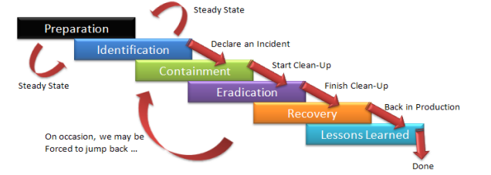
The Incident Response Lifecycle (Based on NIST/SANS)
1. Preparation:
Establishing the CSIRT, tooling, baselines, and communication channels.
2. Detection & Analysis:
Triage process: Validating alerts from IDS/SIEM to declare a formal incident.
determining the Scope of Impact.
3. Containment:
Short-term: Limiting immediate damage (e.g., isolating a VLAN).
Long-term: Restoring systems for production while keeping them isolated.
4. Eradication:
Removing the root cause (e.g., reimaging the host, patching the vulnerability).
5. Recovery:
Restoring operations to normal business hours.
6. Post-Incident Review (Lessons Learned):
Critical for the "Continuous Improvement" cycle.
Audit Focus: Reviewing post-incident reports to ensure root causes were addressed.

Slide 41
Digital Forensics Principles
Locard’s Exchange Principle: "Every contact leaves a trace."
Chain of Custody:
A chronological documentation trail that records the sequence of custody, control, transfer, analysis, and disposition of physical or electronic evidence.
Crucial for CISA: A broken chain of custody renders evidence inadmissible in legal proceedings.
Write Blocking:
Hardware or software tools used to prevent any modification (write actions) to the source drive during acquisition.
Hashing (Integrity Check):
Using algorithms (MD5, SHA-256) to verify that the forensic image is mathematically identical to the original source.

Slide 42
Quiz
Let’s go!

Slide 43
Assignment VII
This assignment is designed to help you review what we've covered so far and prepare for the upcoming mid-term exam.
Please write a summary of each week's lesson here:
https://forms.gle/wSvXuQTEnVVMYnZ3A

